Slide 1
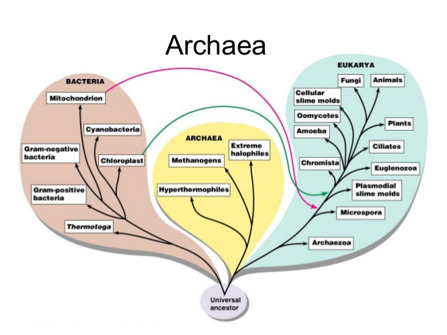
The Diversity of Organisms on this Planet are divided into different Domains
Bacteria
Archaea
Eukarya

Slide 2
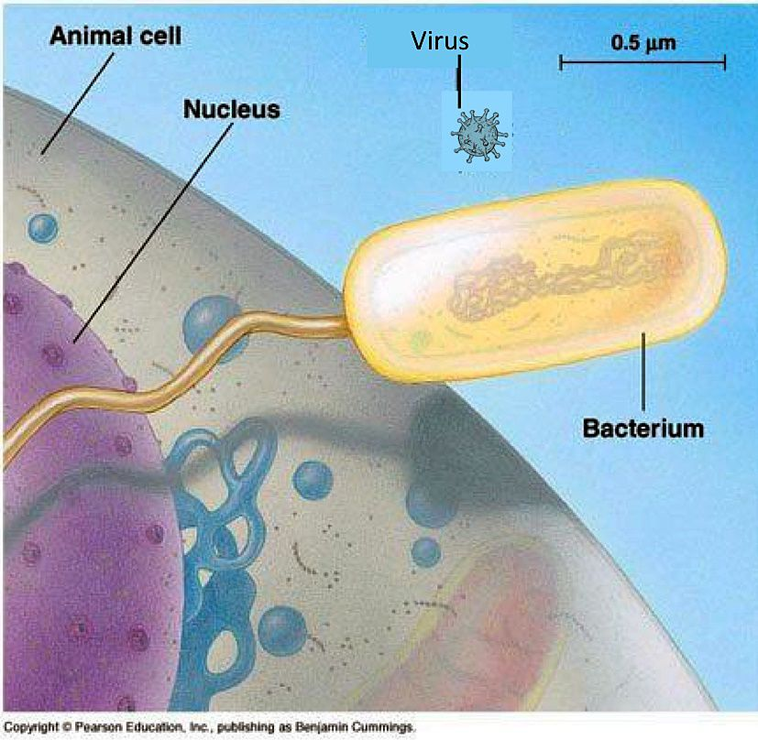
Prokaryotic Cells
Smaller than Eukaryotic Cells
Larger than Viruses
Simple
Single-celled
Lack Organelles
Divide by binary fission

Slide 3
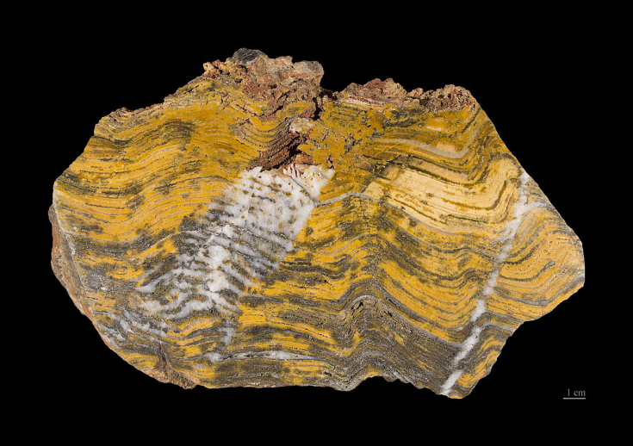
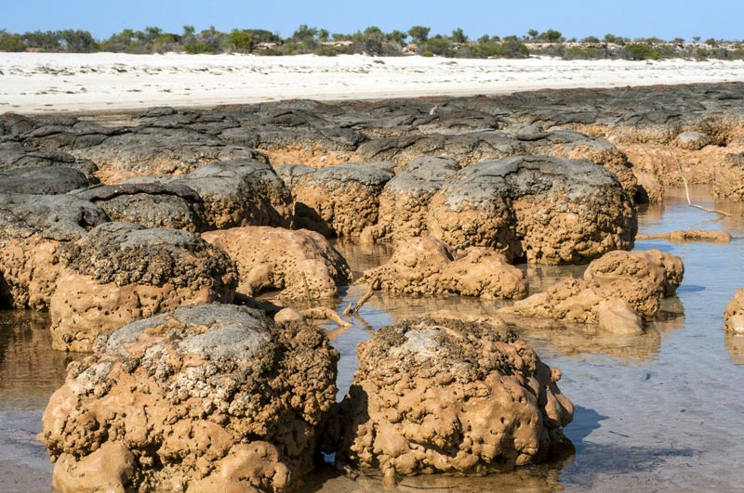
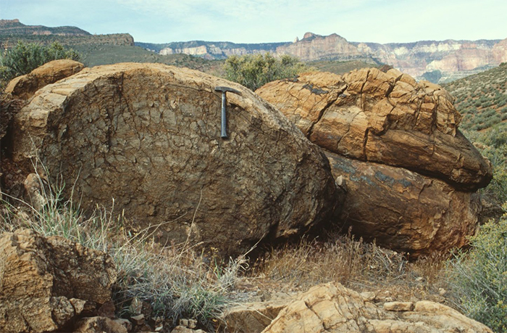
Prokaryotic Cells
The first organisms on this planet were prokaryotic
Oldest fossils of stromatolite bacteria are 3.5 billion years old

Slide 4
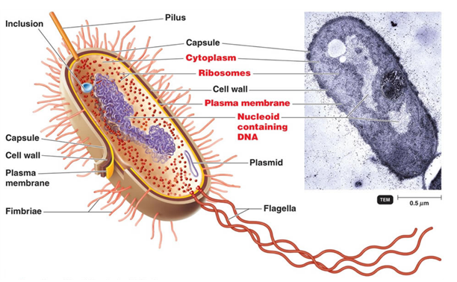
Prokaryotic Cells
Have
unprotected DNA
ribosomes
A plasma membrane
Fimbrae
Capsule
Pillus
Flagella

Slide 5
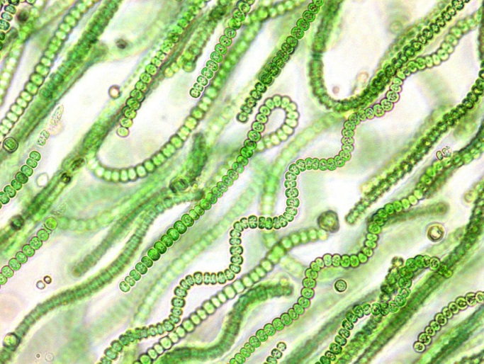
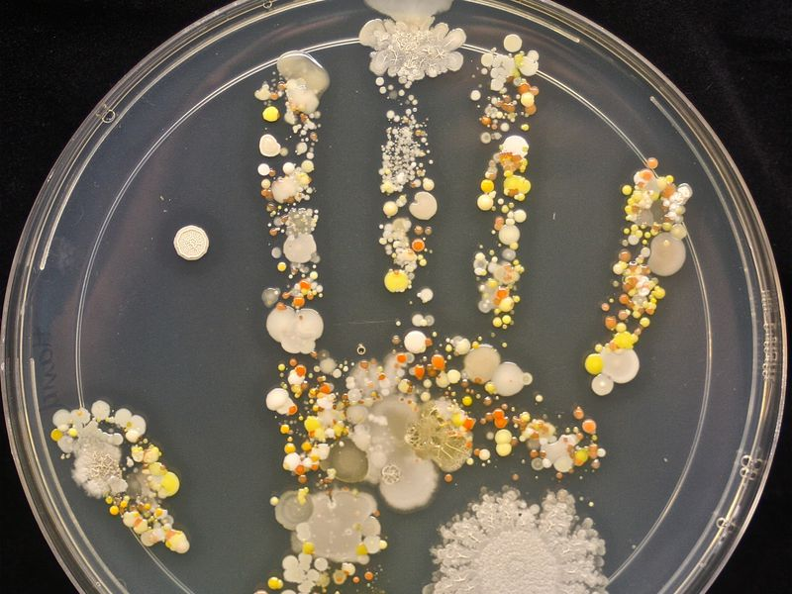
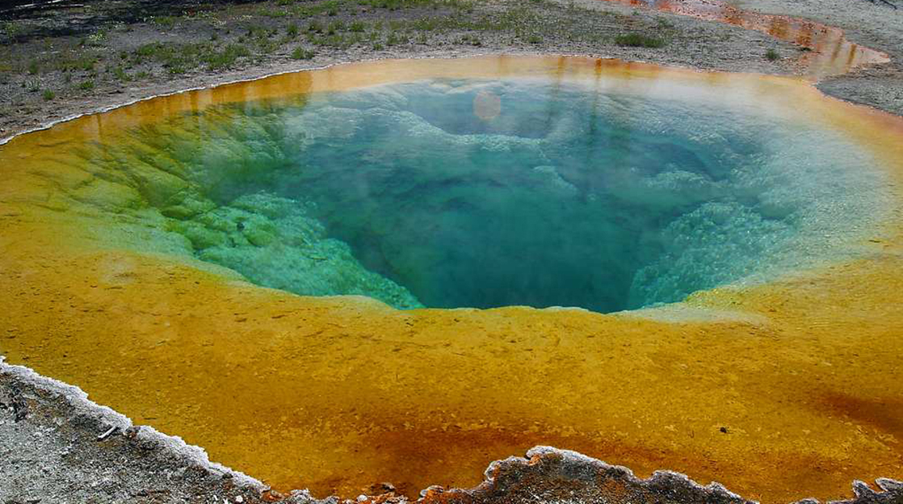
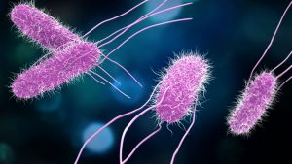
Prokaryotic Cells
Are very diverse and they have impacted the planet’s atmosphere.

Slide 6

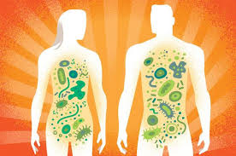
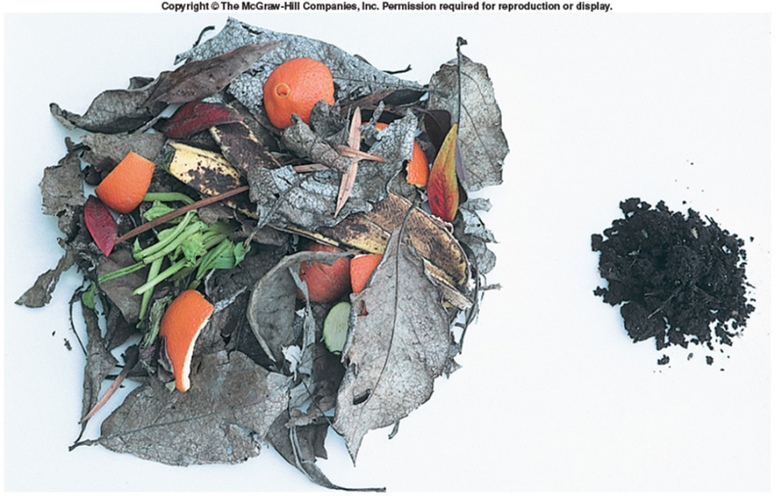
Prokaryotic Cells
Obtain energy in a diverse number of ways:
Some are photoautotrophic
Some are chemoautotrophic
Some are heterotrophic decomposers
Some are heterotrophic pathogens
Some are heterotrophic and mutualistic (microbiome)

Slide 7
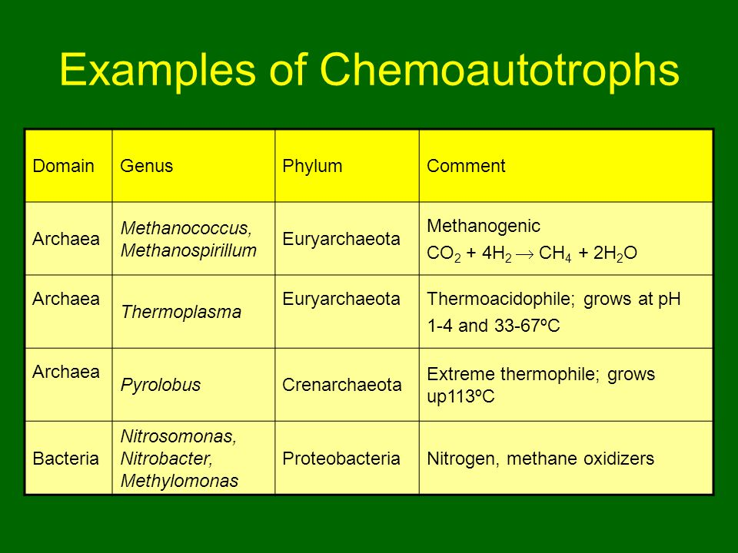
Prokaryotic Cells
Can perform chemosynthesis

Slide 8
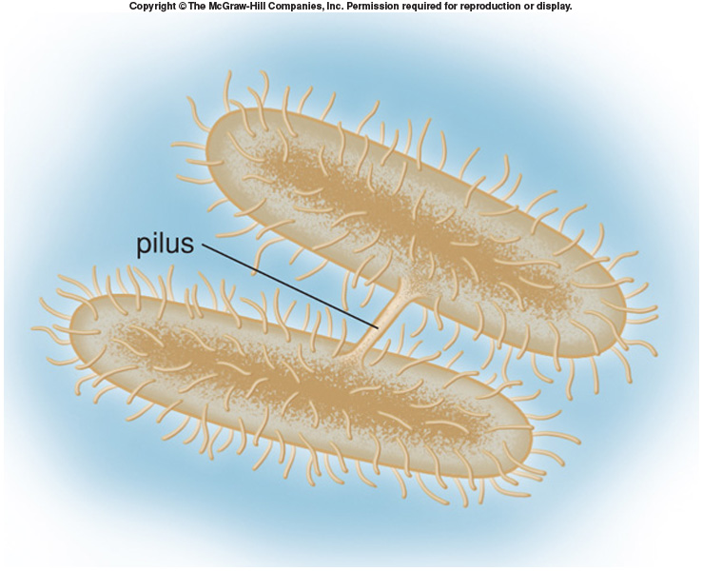
Prokaryotic Cells
Do not have sexual reproduction BUT, they have three ways to obtain genetic diversity:
Conjugation
DNA transferred from donor cell to recipient cell usually through pilus (pleural: pili).
Transformation
Living cell acquires DNA fragments released by dead cells.
Transduction
DNA fragments carried from one cell to another by viruses.
Conjugation

Slide 9
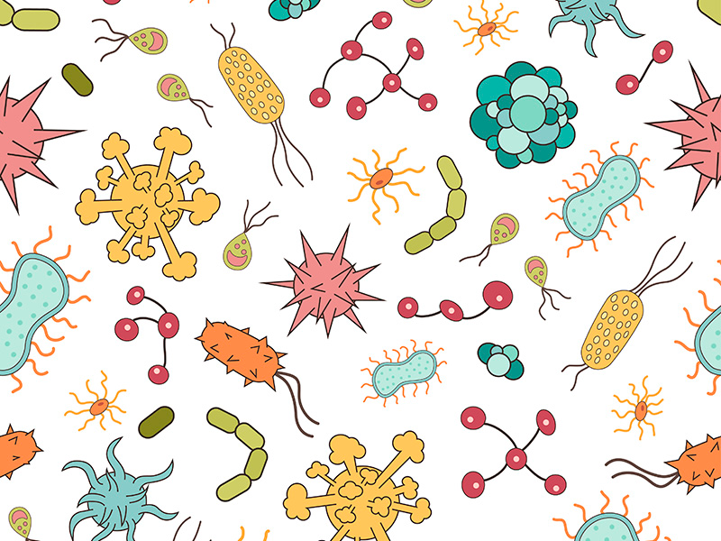
Domain Bacteria
Includes:
Autotrophic bacteria
Photosynthetic without producing oxygen
Chemosynthetic bacteria - Obtain energy from various compounds or elements through oxidation
Decomposing bacteria
Pathogenic bacteria (strep throat)
Helpful bacteria (microbiome)

Slide 10
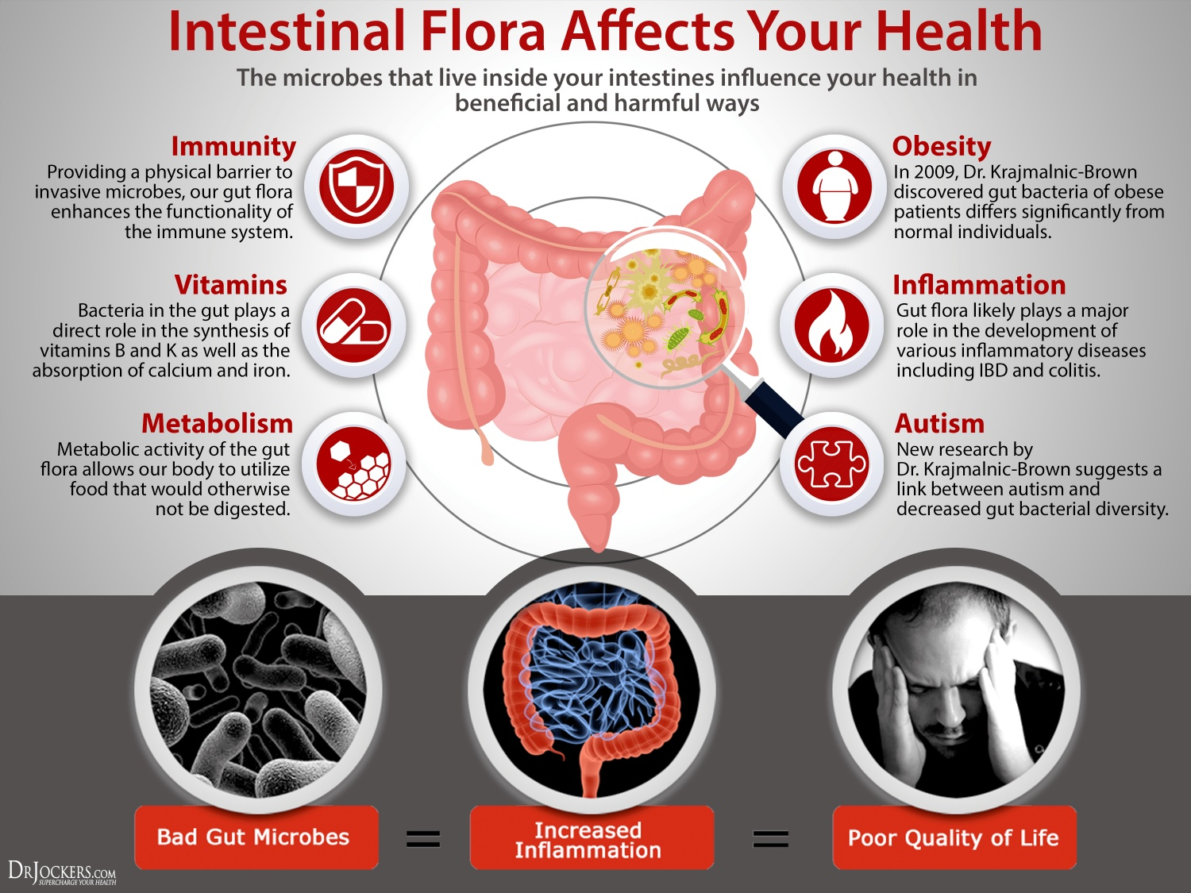
Domain Bacteria
The kinds of bacteria that make up our gut flora influence our health in many ways

Slide 11
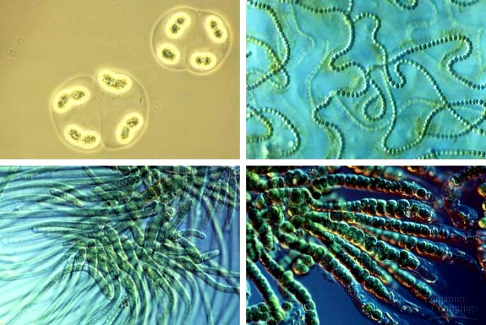
Domain Bacteria
Cyanobacteria photosynthesize

Slide 12
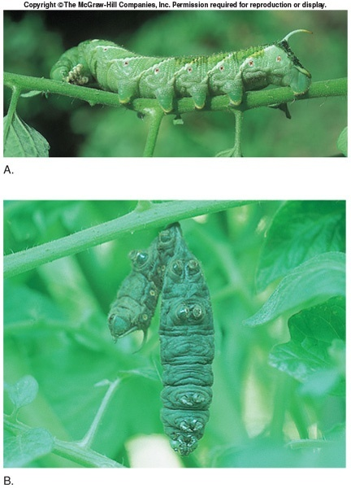
Domain Bacteria
Bacteria are useful to humans:
Biological control organisms
Bacillus thuringiensis - Effective against caterpillars and worms
Bioremediation - Use of living organisms in cleanup of toxic waste and pollution
Affect of Bacillus thuringiensis on tomato hornworm

Slide 13
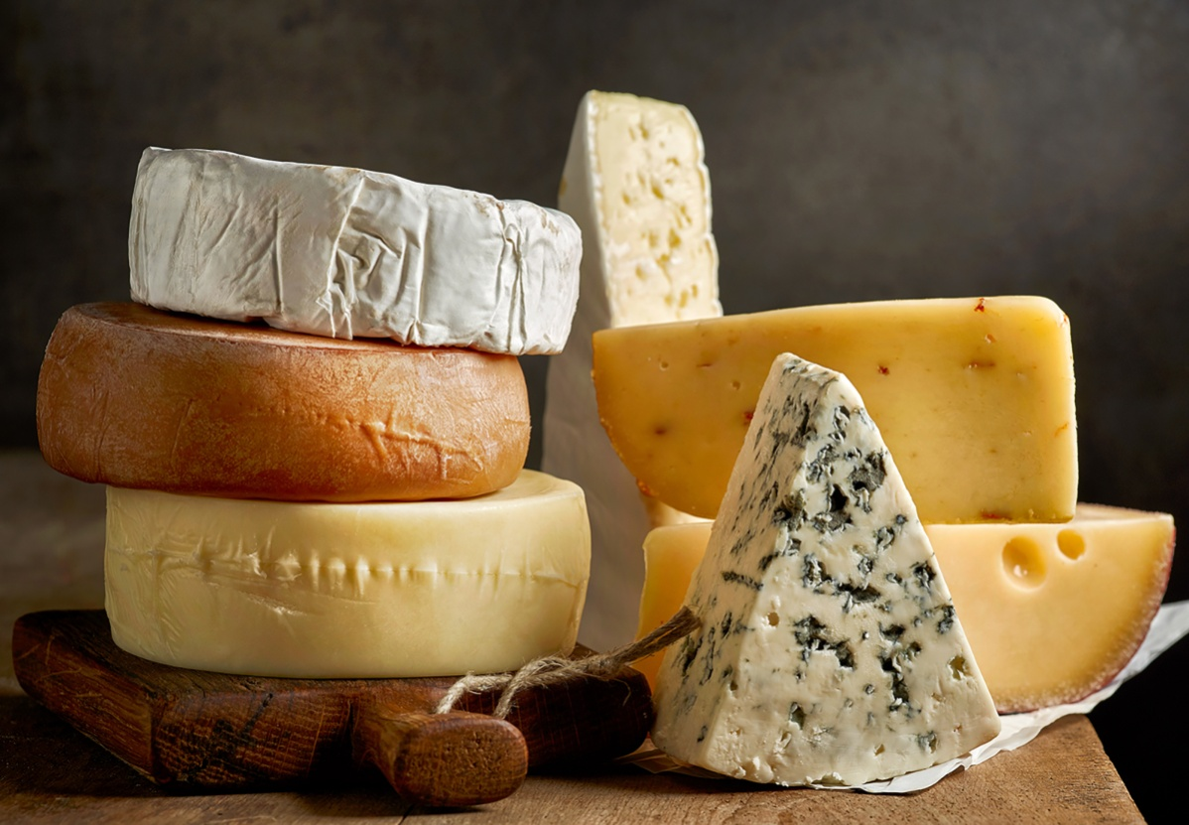
Domain Bacteria
Bacteria are useful to humans:
Other useful bacteria
Human health - Lactobacillus acidophilus
Dairy - Buttermilk, sour cream, yogurt, cheese
Industrial - Utilizes bacteria waste products

Slide 14
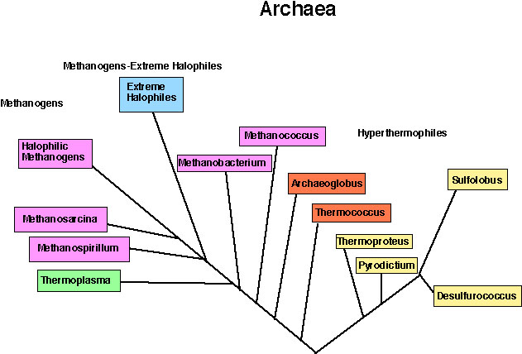
Domain Archaea
Is diverse

Slide 15
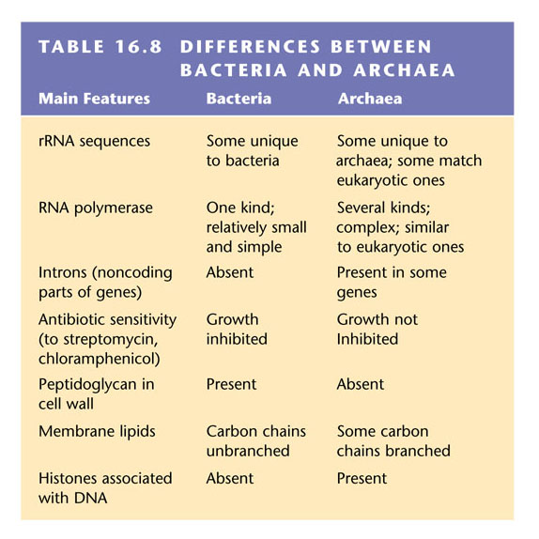
Domain Archaea
Are similar to Bacteria in that they are prokaryotic but have some significant differences

Slide 16
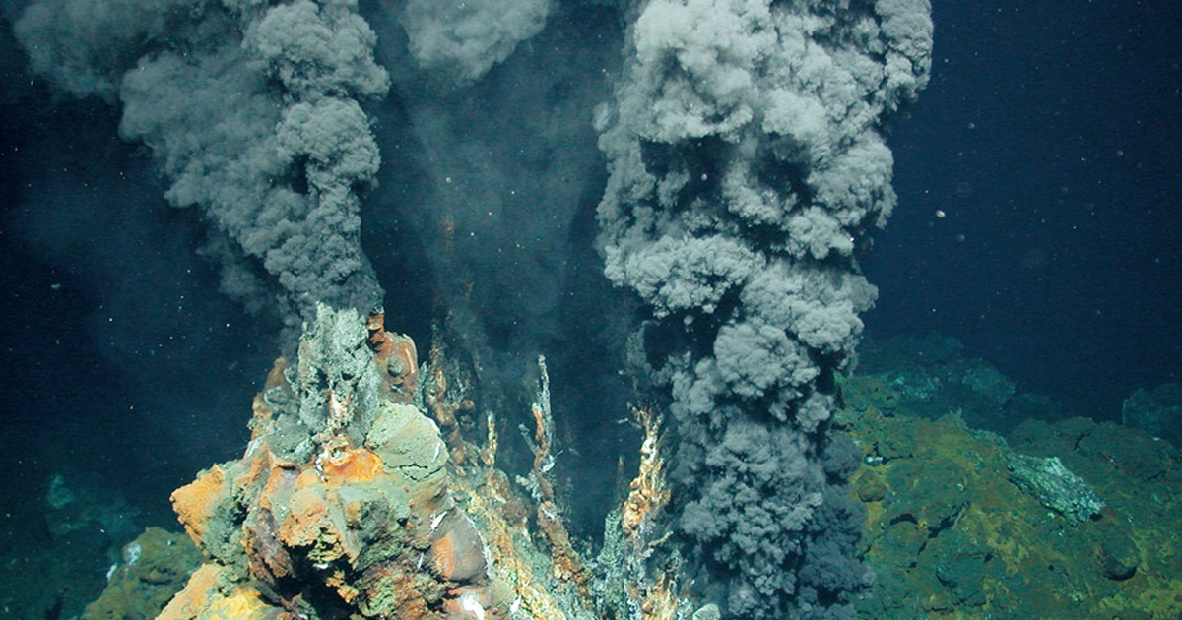
Domain Archaea
Include
methanogens (which produce methane gas)
halophiles (salt lovers)
thermophiles (heat lovers)
Notes:
Figure 8.3-2e Halophiles–5 of 5

Slide 17
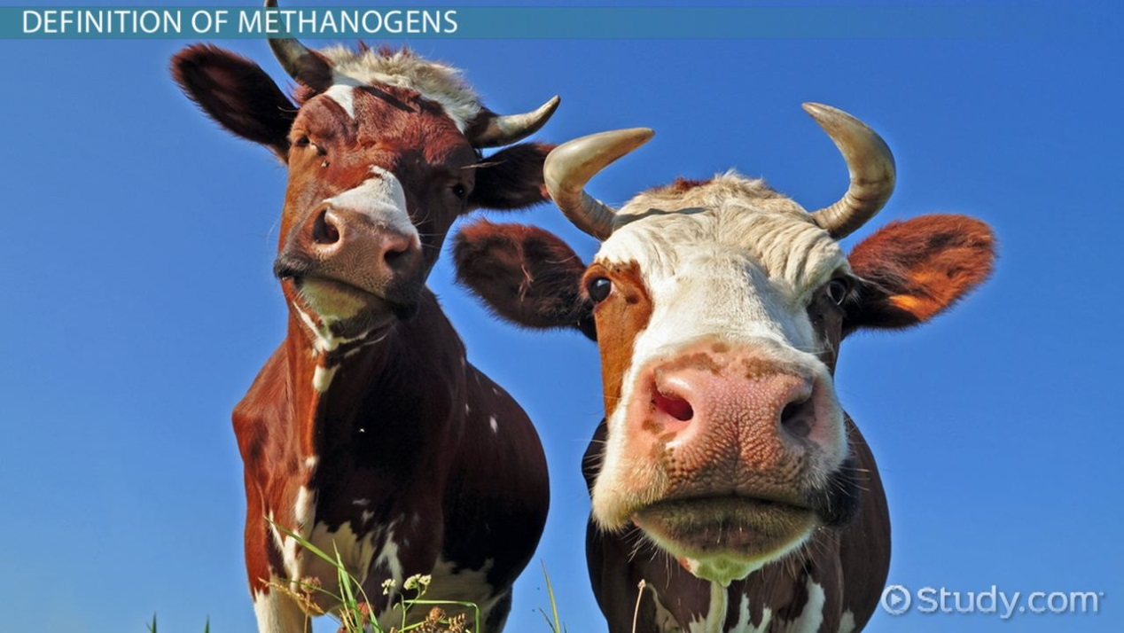
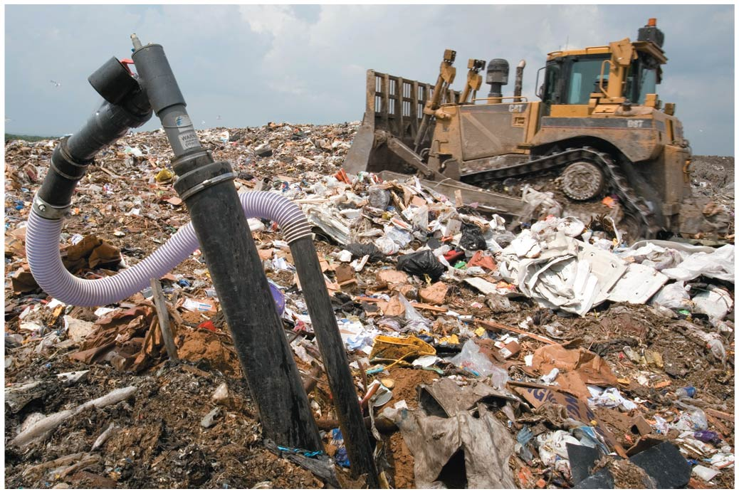
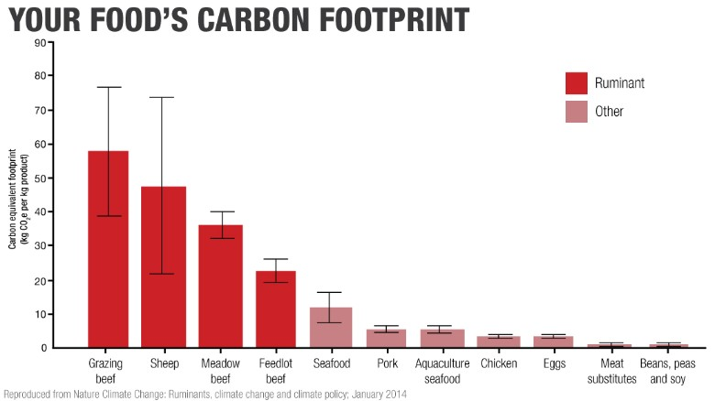
Domain Archaea
Methanogens live in anaerobic environments
Notes:
Figure 8.3-1b Methanogens–2 of 4

Slide 18
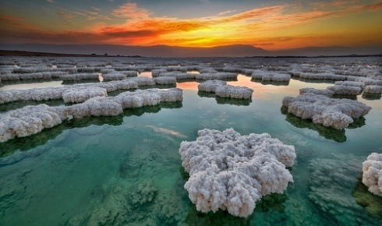
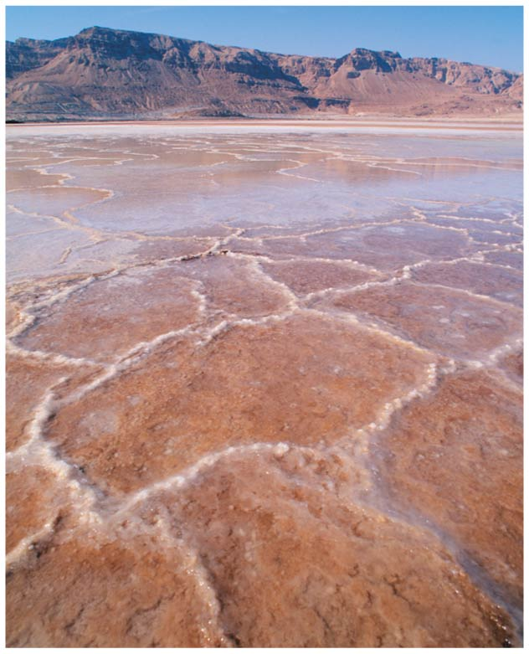
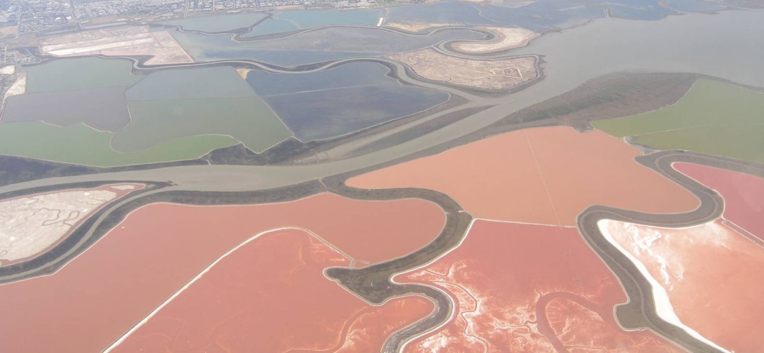
Domain Archaea
Halophiles live in very salty environments
Notes:
Figure 8.3-2a Halophiles–1 of 5

Slide 19
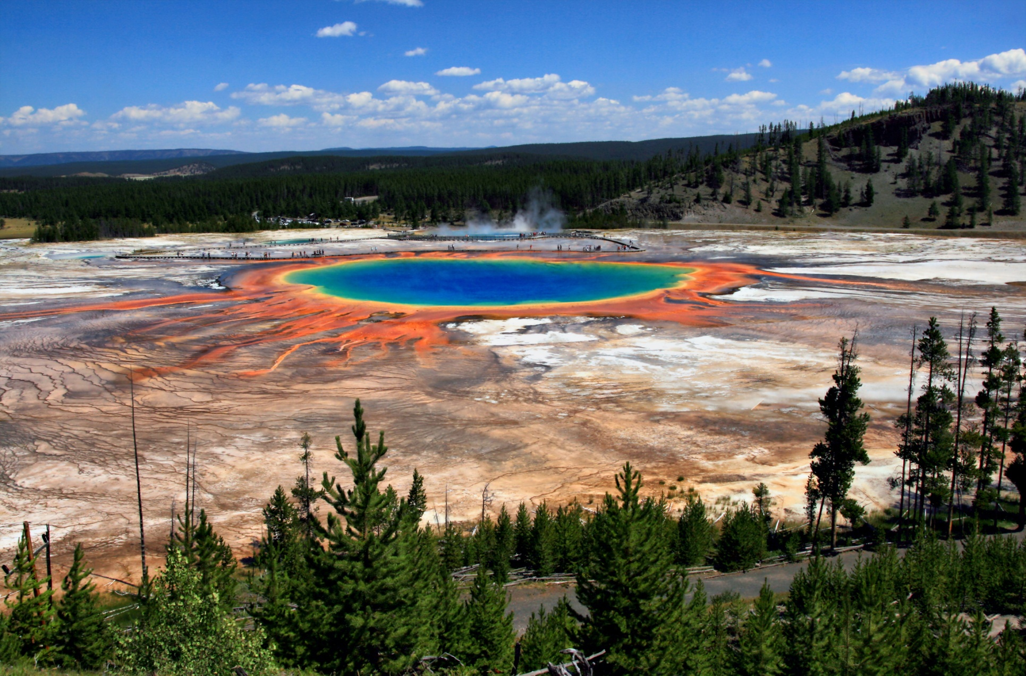
Domain Archaea
Thermophiles thrive in very hot environments

Slide 20
Endosymbiosis
Evidence suggests that endosymbiosis was key in the evolution of eukaryotes
Endosymbiosis is when one species lives inside another host species.
Two eukaryotic organelles, mitochondria and chloroplasts, appear to have evolved from small, free-living prokaryotes that were engulfed by the host cell.

Slide 21
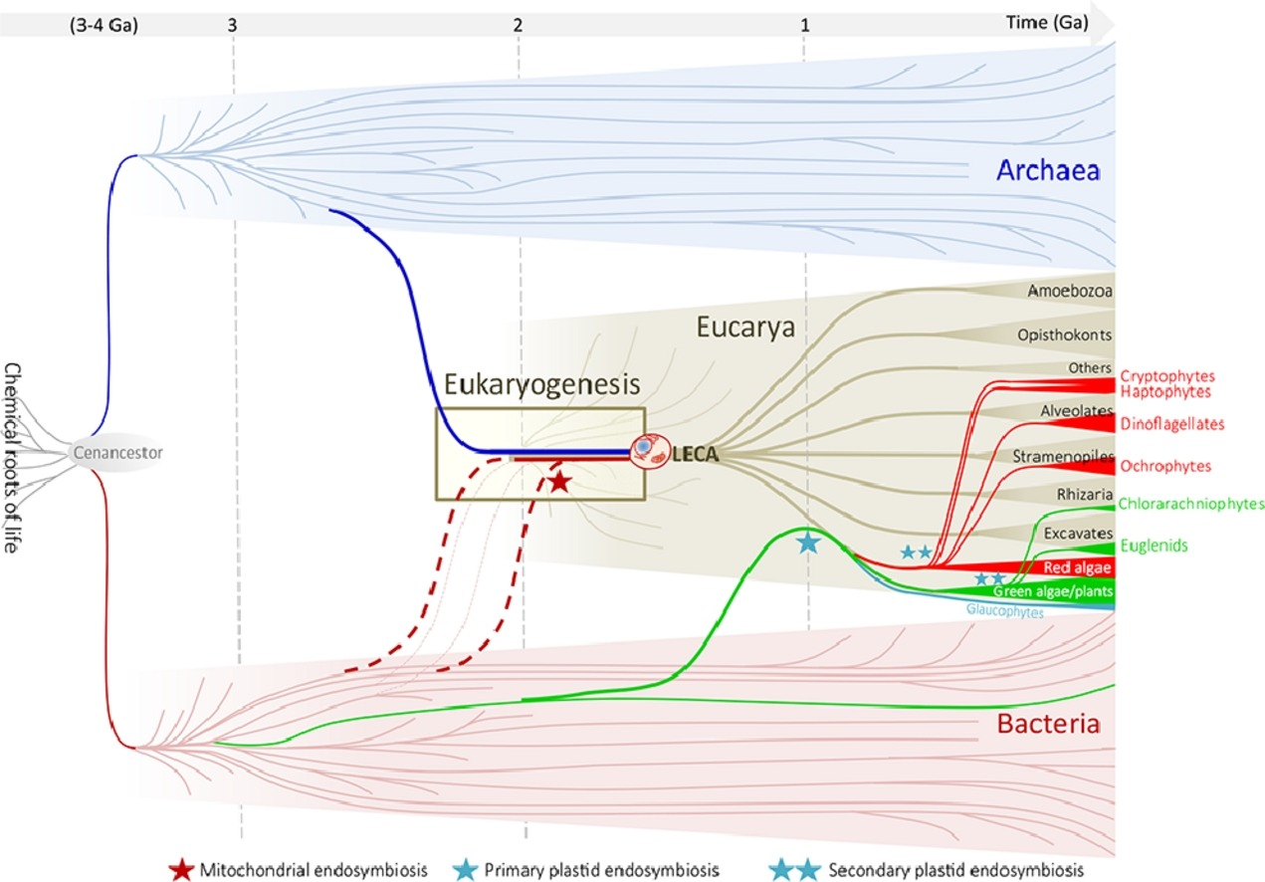
Endosymbiosis
Illustrated on an evolutionary tree

Slide 22
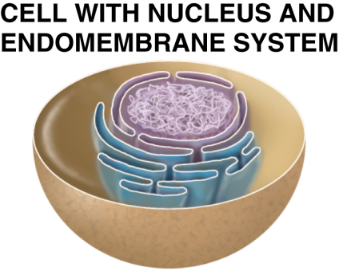
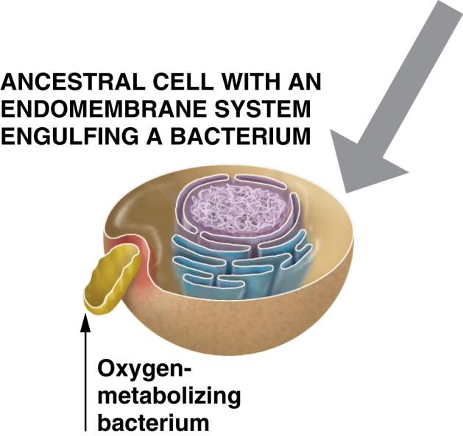
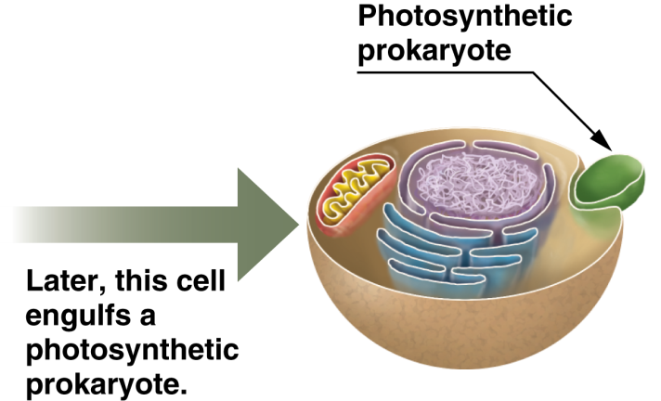
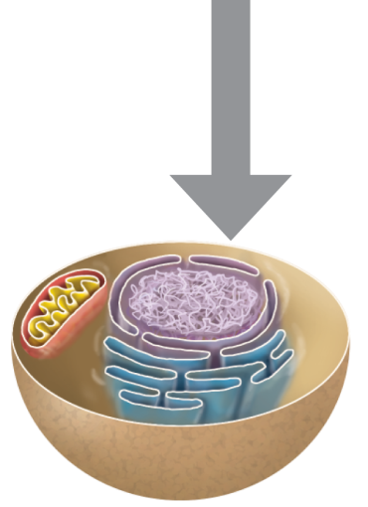
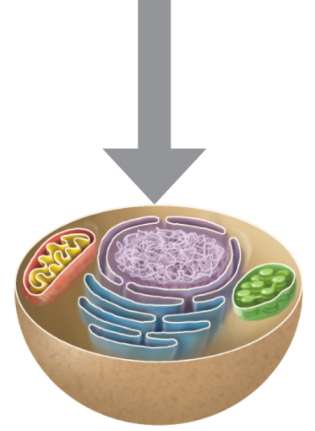
Endosymbiosis
Formed the
Mitochondria
Chloroplast
Notes:
Figure 8.6-2_5 Endosymbiosis (Step 5)

Slide 23
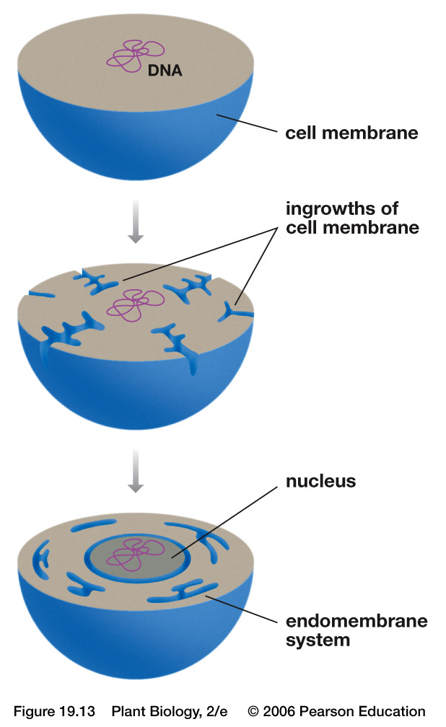
In-folding of the Plasma Membrane
Formed the
Nucleus
Endoplasmic Reticulum
Golgi Apparatus

Slide 24
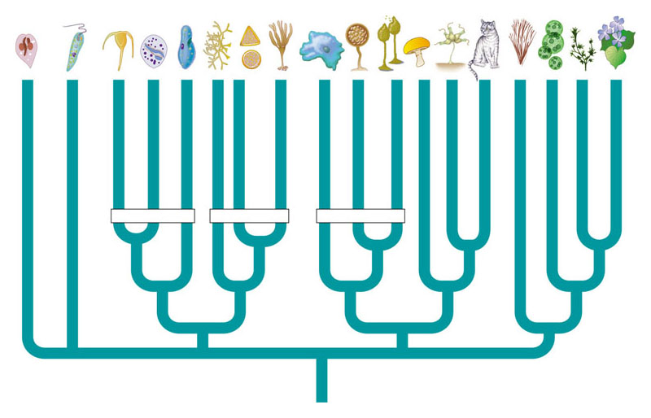
Domain Eukarya
A tentative phylogeny of eukaryotes includes multiple clades of protists
Ciliates
Diatoms
Amoebas
Fungi
Animals
Plants
Water molds
Red algae
Diplomonads
Apicomplexans
Brown algae
Green algae
Euglenozoans
Dinoflagellates
Choanoflagellates
Cellular slime molds
Plasmodial slime molds
Closest algal relatives of plants
Alveolates
Stramenopila
Amoebozoa
Ancestral eukaryote

Slide 25
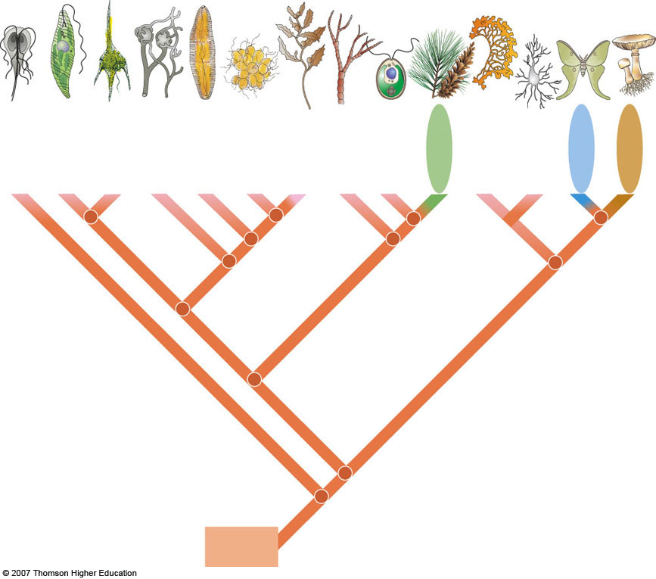
Some
zooflagellates
Dinoflagellates
Brown algae
Plasmodial
slime molds
Cellular
slime molds
Euglenoids
Water molds
Golden algae
Green algae
Diatoms
Red algae
Land plants
Animals
Fung
Ancestral
eukaryote

Slide 26
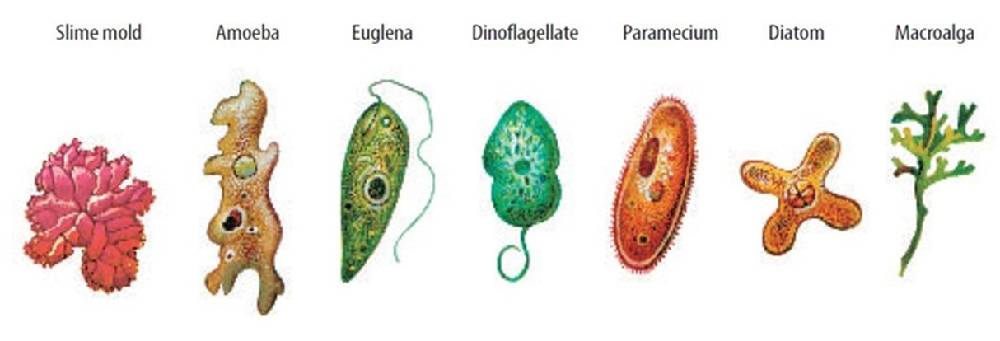
“Protists” you need to know
Protozoans
Algae
Green Algae
Brown Algae and Diatoms
Red Algae
Dinoflagellates
Slime Molds

Slide 27
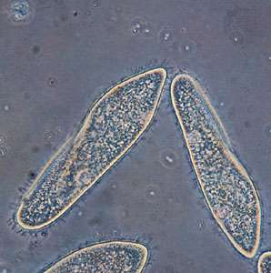
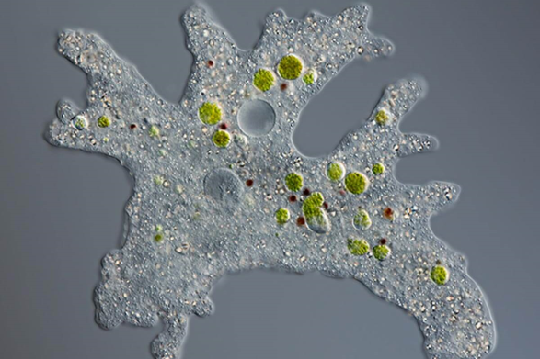
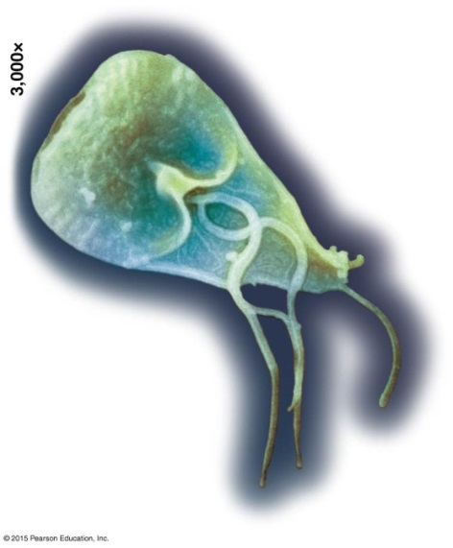
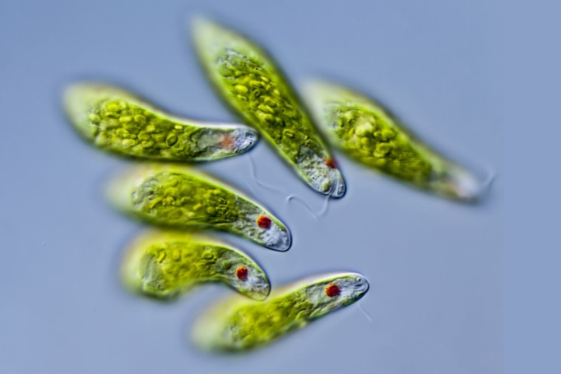
Protozoans
Move and obtain nutrients by eating (heterotrophic).
Paramecium move with
hair-like cilia.
Amoeba moves with cytoplasmic streaming and pseudopods.
Giardia is an intestinal parasite.
Euglena move with
flagella.
Notes:
Figure 8.7-1a Protozoans–1 of 3
Figure 8.7-1b Protozoans–2 of 3
Figure 8.7-1c Protozoans–3 of 3

Slide 28
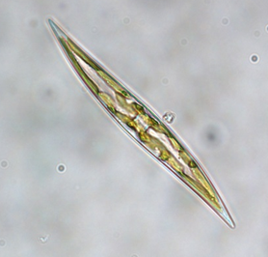
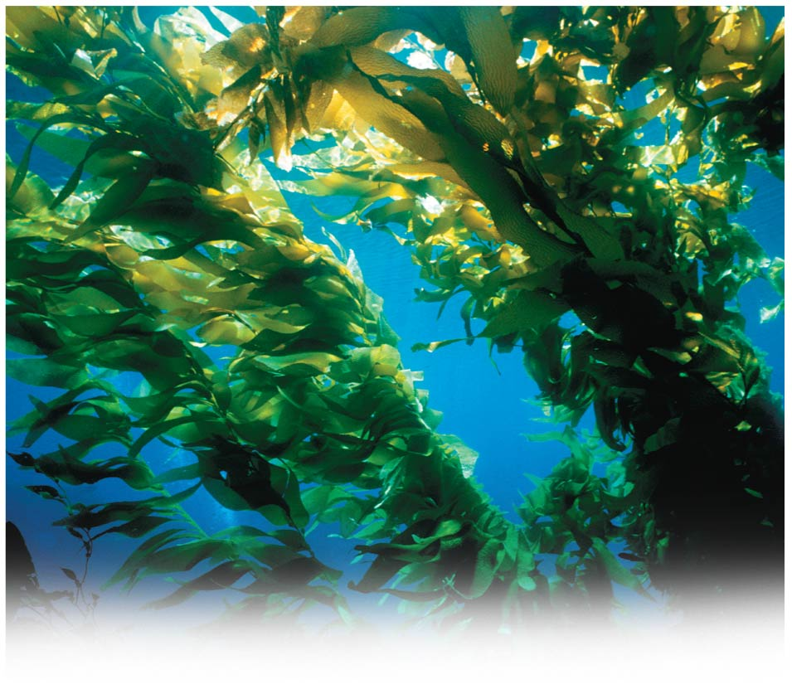
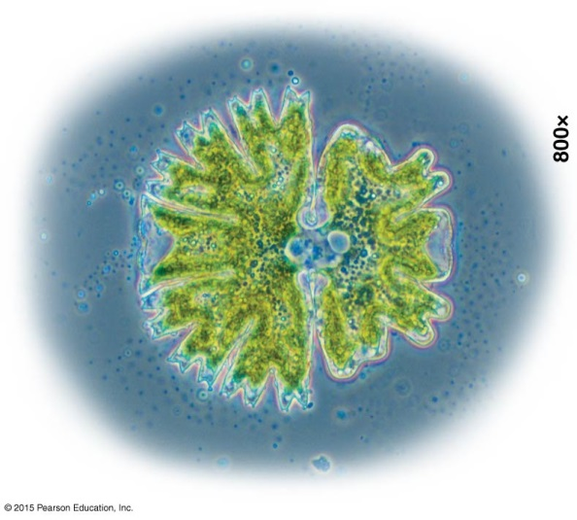
Algae
Algae (singular, alga) are photosynthetic protists able to produce their own food (autotrophic)from sunlight.
Diatom
Unicellular green algae
Seaweeds are large, multicellular marine algae
Notes:
Figure 8.7-4b Algae–2 of 4
Figure 8.7-5c Seaweeds–3 of 3

Slide 29
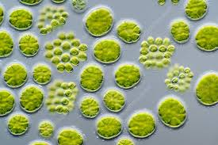
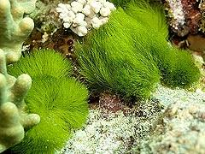
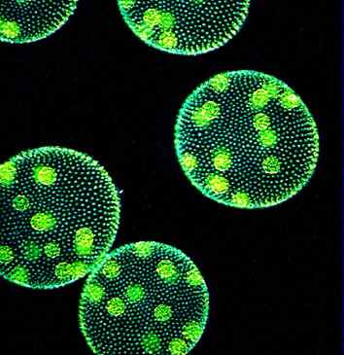
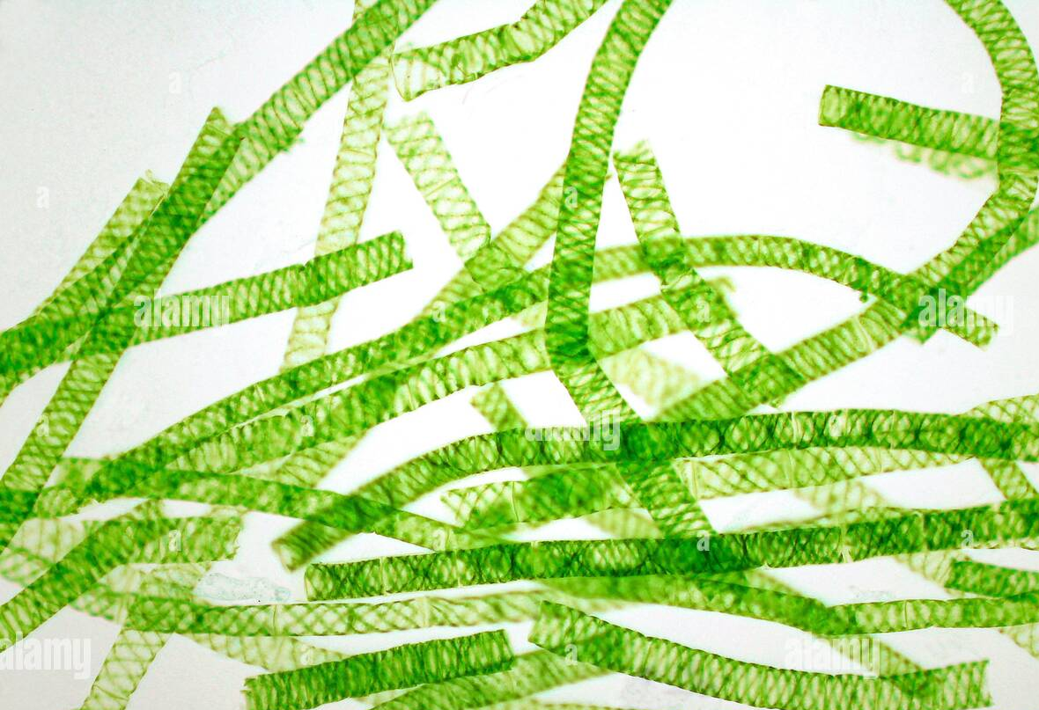




Algae
Green algae
Have chlorophylls a and b
Store food as starch
Cell walls made of cellulose
Can be unicellular, a blade form, filamentous or colonial

Slide 30



Algae
Brown algae & Diatoms
Chlorophylls a and c and fucoxanthin
Store food as Oil, fats or laminarin
Include large kelps, smaller brown algae and unicellular diatoms

Slide 31



Algae
The Diatoms
A type of phytoplankton
As much as 95% of wall is silica.

Slide 32


Algae
Brown Algae
Have algin in their cell walls
Include the kelps with complex structures:
Holdfast
Stipe
Air bladder
Blades
Nereocystis, a kelp

Slide 33



Algae
Brown Algae (alginate)
Are important in many food products
Are important in many industrial products

Slide 34







Algae
Red algae
Colors mostly due to phycobilins.
Chlorophylls a, and sometimes d
Store food as Floridean starch
Cell walls with carageenan and agar.

Slide 35





Algae
Red Algae (agar & carageenan)
Are important in many food products
Are important in many industrial products

Slide 36

Algae
The Dinoflagellates
Another type of phytoplankton
Two flagella in intersecting grooves
Can cause toxic algal blooms
Can bioluminesce

Slide 37


Algae
Some Dinoflagellates bioluminesce

Slide 38


Slime Molds
Feed on bacteria and other organic particles

Slide 39


Slime Molds
Alternate between single celled phases and multicellular phases

Slide 40

Slime Molds
Disperse using spores

Slide 41
Slime Molds
protoplasmic streaming
growth of a slime mold
slime mold slug
In depth with slime molds
Slime mold “intelligence”

